Slide 1

Google Business
For seo & improved localization
Alton J. Duderstadt II
President/Chief Searchologist
312.316.7202
  Text or call
  altonjd2@gmail.com
www.Searchology.com or www.Searchology.biz

Slide 2
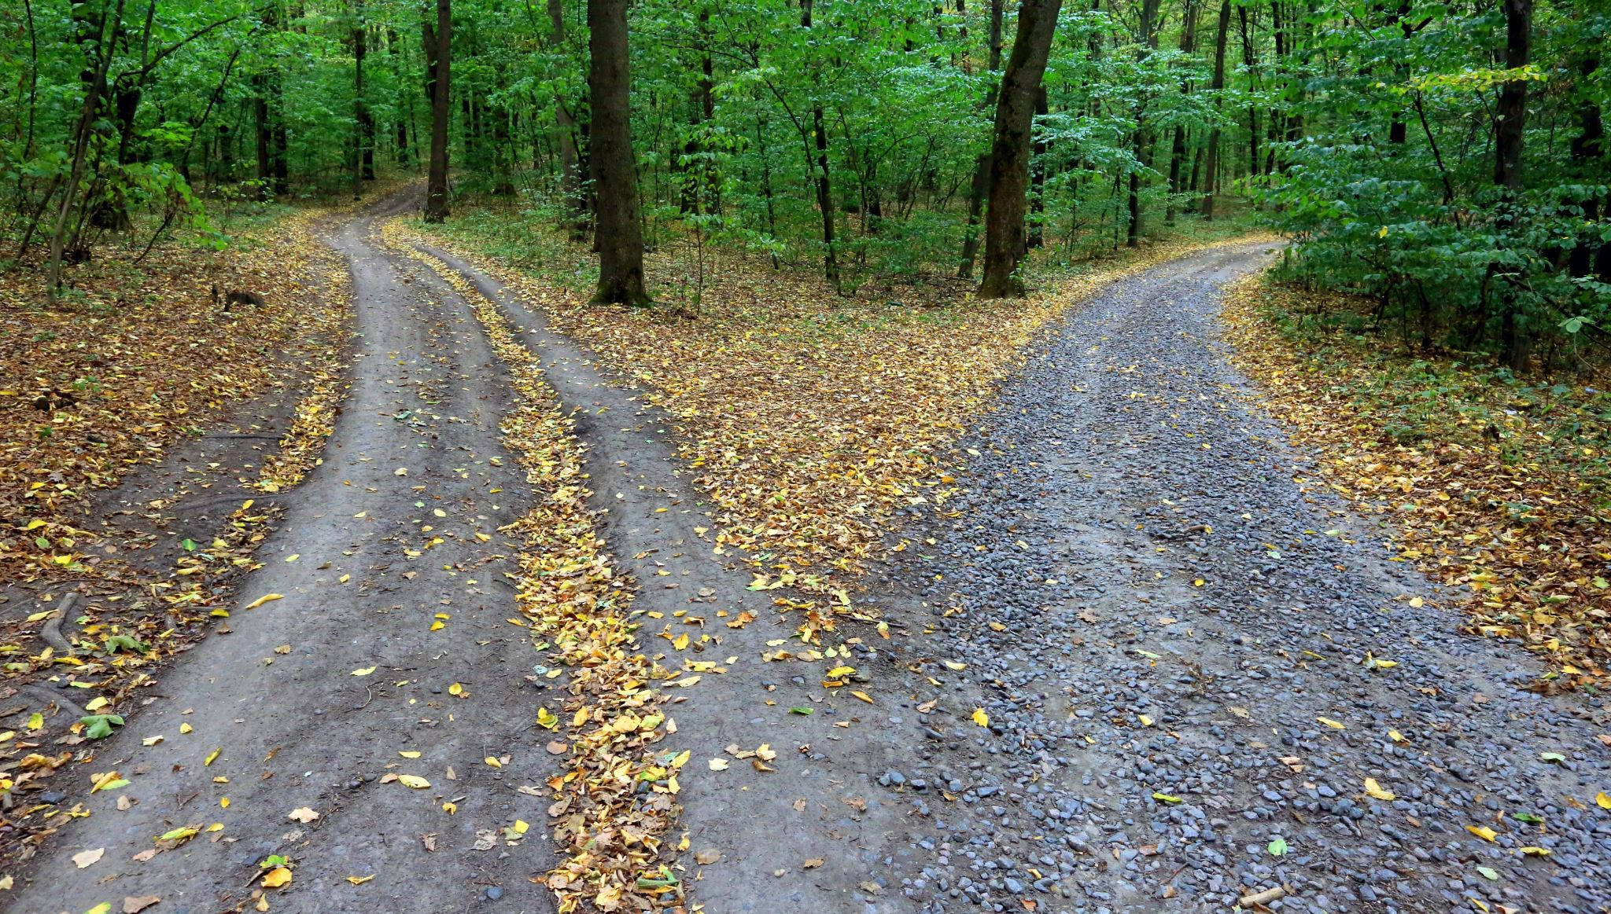
Agenda
Thank you! For your attendance & for our sponsors
About Searchology
Notes/Acknowledgements
Digital Marketing Overview
Intro to Google Business
Top Tips
Timing & Consistency

Slide 3

Our Sponsors
Thank you!
Special Thanks - Yorkville Area Chamber of Commerce
Massage by Tamiko
The DeLeno Group – Keller Williams Infinity
Special Thanks - Yorkville Area Chamber of Commerce
  Alex Douglas – Membership Assistant
  Renee Kryger – President/CEO

Slide 4
About Searchology & Alton J. Duderstadt II
Searchology, Inc.
Established in 2009
WordPress design, search engine optimization, paid search advertising, local listings, reputation management [and reviews], media buying, strategic development, digital transformations, and full digital marketing/advertising services
Sample clients: Harley Davidson, Buell Motorcycles, Chicago Board of Trade, Sunrise Senior Living, Summer Fest, Marc Anthony, Otto Bock, Honeywell Aerospace, Medela Breast Pumps, BHHS Chicago, Kelly Services, Creative Circle, American Academy of Orthopedic Surgeons, and many more.
Alton J. Duderstadt II
President/Chief Searchologist [Searchology, Inc.]
23 years in digital marketing & advertising
Past adjunct professor of digital marketing – Columbia College Chicago
Past Midwest trainer – Digital Marketing & Google Analytics – Imparture Training

Slide 5
Searchology™~ Services
WordPress website design and redesign
SEO – on and off page
Paid Search Audits
Custom Digital Marketing Workshops
Corporate Training
SEO Audits
Paid Search – Google Ads
Google Tracking/Reporting
Social Media Content and Content Distribution
Local Listings/Listing Management/Local Citations
Digital Strategy & Digital Transformation
Competitive Research & Analysis

Slide 6

Notes/Acknowledgements
Acknowledgements ~
Take control of your personal and professional brand
Online Reviews matter
Pay to reach the top of the search results
Use free tools to help you find your niche, market, and correct keywords
Don’t fall for scams – no company or person can guarantee top position on Google
It can take upto 15 touch points to reach your audience
Notes ~
Education will be the key for relators in 2024 [and onward]

Slide 7
Digital Marketing Overview
Ten Disciples of Digital Marketing
Website/website design
Tracking & analysis
Paid search marketing
Social media marketing & optimization
Search engine optimization
Content development, creation, and distribution
Email marketing
Affiliate marketing
Mobile marketing
Display and contextual marketing

Slide 8

Internet Marketing [hot] Sheet
Mobile search – 87% of internet users use more than once device and 60% of customers call a business directly from their phones
Voice search – 65% of website users 25 to 49 use voice search once a day
70% of users use ‘click to call feature’
  Source: https://blog.shift4shop.com/top-digital-marketing-channels-statistics
Mobile – 58% of searches start on a mobile device
Desktop – 40% desktop
Only 49% of businesses use digital marketing but do not have a proper game plan

Slide 9

Search Types [Intent]
Branded search – users are looking for a brand, company name, personal brand, product brand, service brand, etc.
Informational search – largest search type…seeking general information about a topic.
Transactional search – individuals who are looking to make a purchase, sign up, contact, or other transactional action.
Navigational search – yes, individuals still type in full domain names.
Commercial intent – users seeking product or service information.

Slide 10

Key Digital Marketing Elements for 2024 & Beyond
Keys to elevate your empire

Slide 11
2024 digital trends
AI – artificial intelligence – quality property listings, content creation, content ideation
“Helpful Update” – Google Algorithm update [new] – How useful is your content based on user “intent”?
Content – Freshness, quality, quantity of on-page content
Paid Search – local search, property search, branded search
Local – local listings [Google & Bing]
SEO – Search engine optimization
Video and images – “Imagine Yourself Here”
Voice Search – the long tail search query
Responsive websites / mobile website design
Content for your specific audience and matching intent [page content & search intent]

Slide 12
Real Estate is location, location, location…so is digital marketing
Search engine optimization
On-page
Off-page
Technical
Page content
Completive research and analysis
Social media and social signals
Paid search advertising
Website design/UX/UE/testing
Local SEO
Website content/content strategy/content distribution
Tracking and evaluation of results

Slide 13

What you should be Focused on for 2024

Slide 14

Focus On These…
Emergence of AI [artificial intelligence]
Website and on-page content
Website security and corporate security
Channel identification
Website tracking
Organizational Structure as it pertains to marketing and digital marketing efforts
Inclusive digital marketing efforts
How to tell YOUR story
Selling the WHY not the What

Slide 15

Google Business
Why it matters to you and your audience

Slide 16

Sharks in the digital waters…
"Hi, this is Brittany with your verified. Now, we've been trying to contact you about your Google business listing. Our records show your Google business listing is not properly verified with Google. This can cause customers searching for your services to not be able to find your business online. Call us back at 555*555*5555. So we can quickly check the status of your Google business listing. This will only take a few minutes.”
THIS text or similar call is a SCAM

Slide 17

Why Google Business Matters
93% of Internet users are looking for local businesses and services
Over 42% of Internet users click on the local ‘map pack’
58% of companies don’t utilize local search
  Source: onthemap.com
93% of users rely on Google Reviews to make buying decisions
75% of companies do not respond to negative reviews
Google, Facebook, Yelp, and TripAdvisor make up 88% of all online reviews
  Source: explodingtopics.com/blog/online-review-stats
It’s 100% free to use, update, and promote your business
  Source: Searchology
Google Business shows up in position 3 to 4 right after paid search results [in the SERPS]

Slide 18
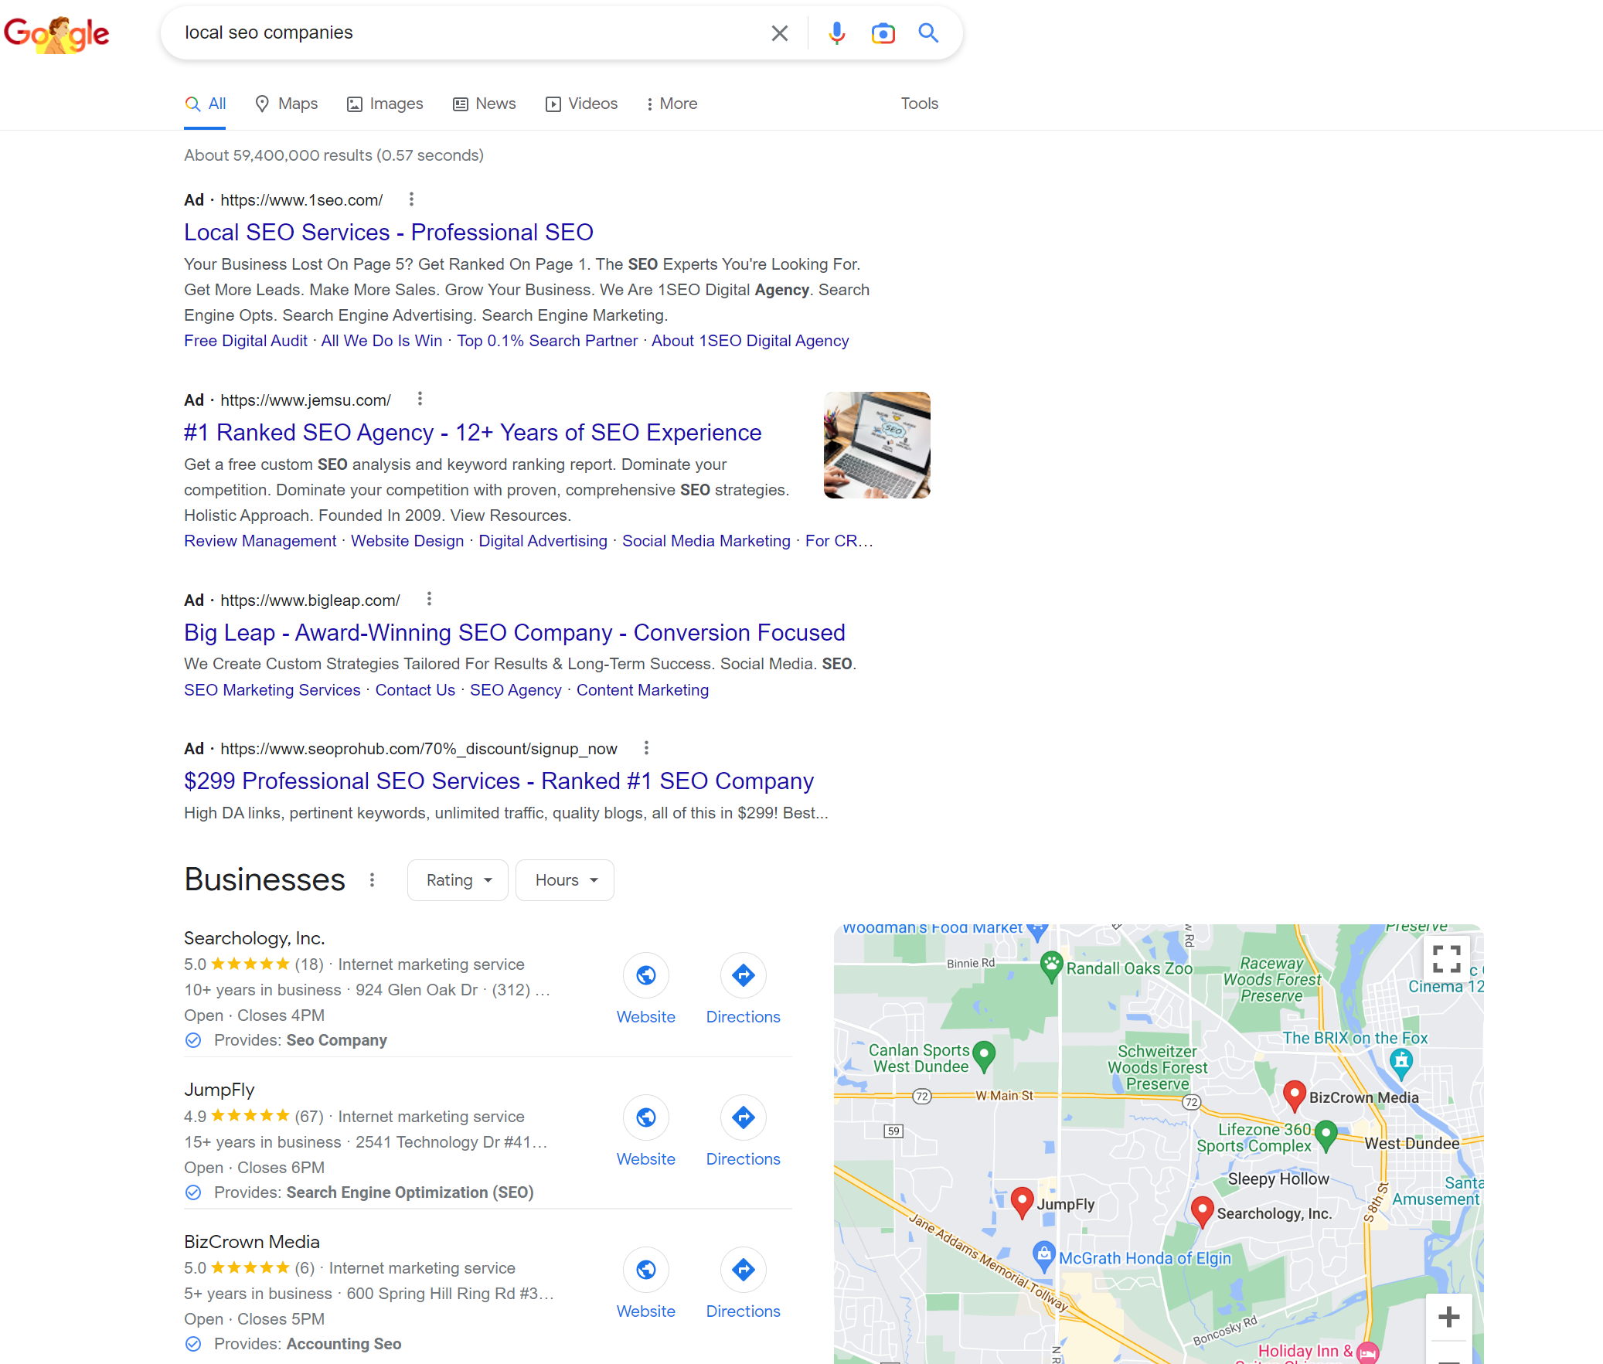
What is Google Business? [Fig. 1]
Search term = “local SEO companies”
About 59,400,000 results
Paid Ads
Local Listings

Slide 19
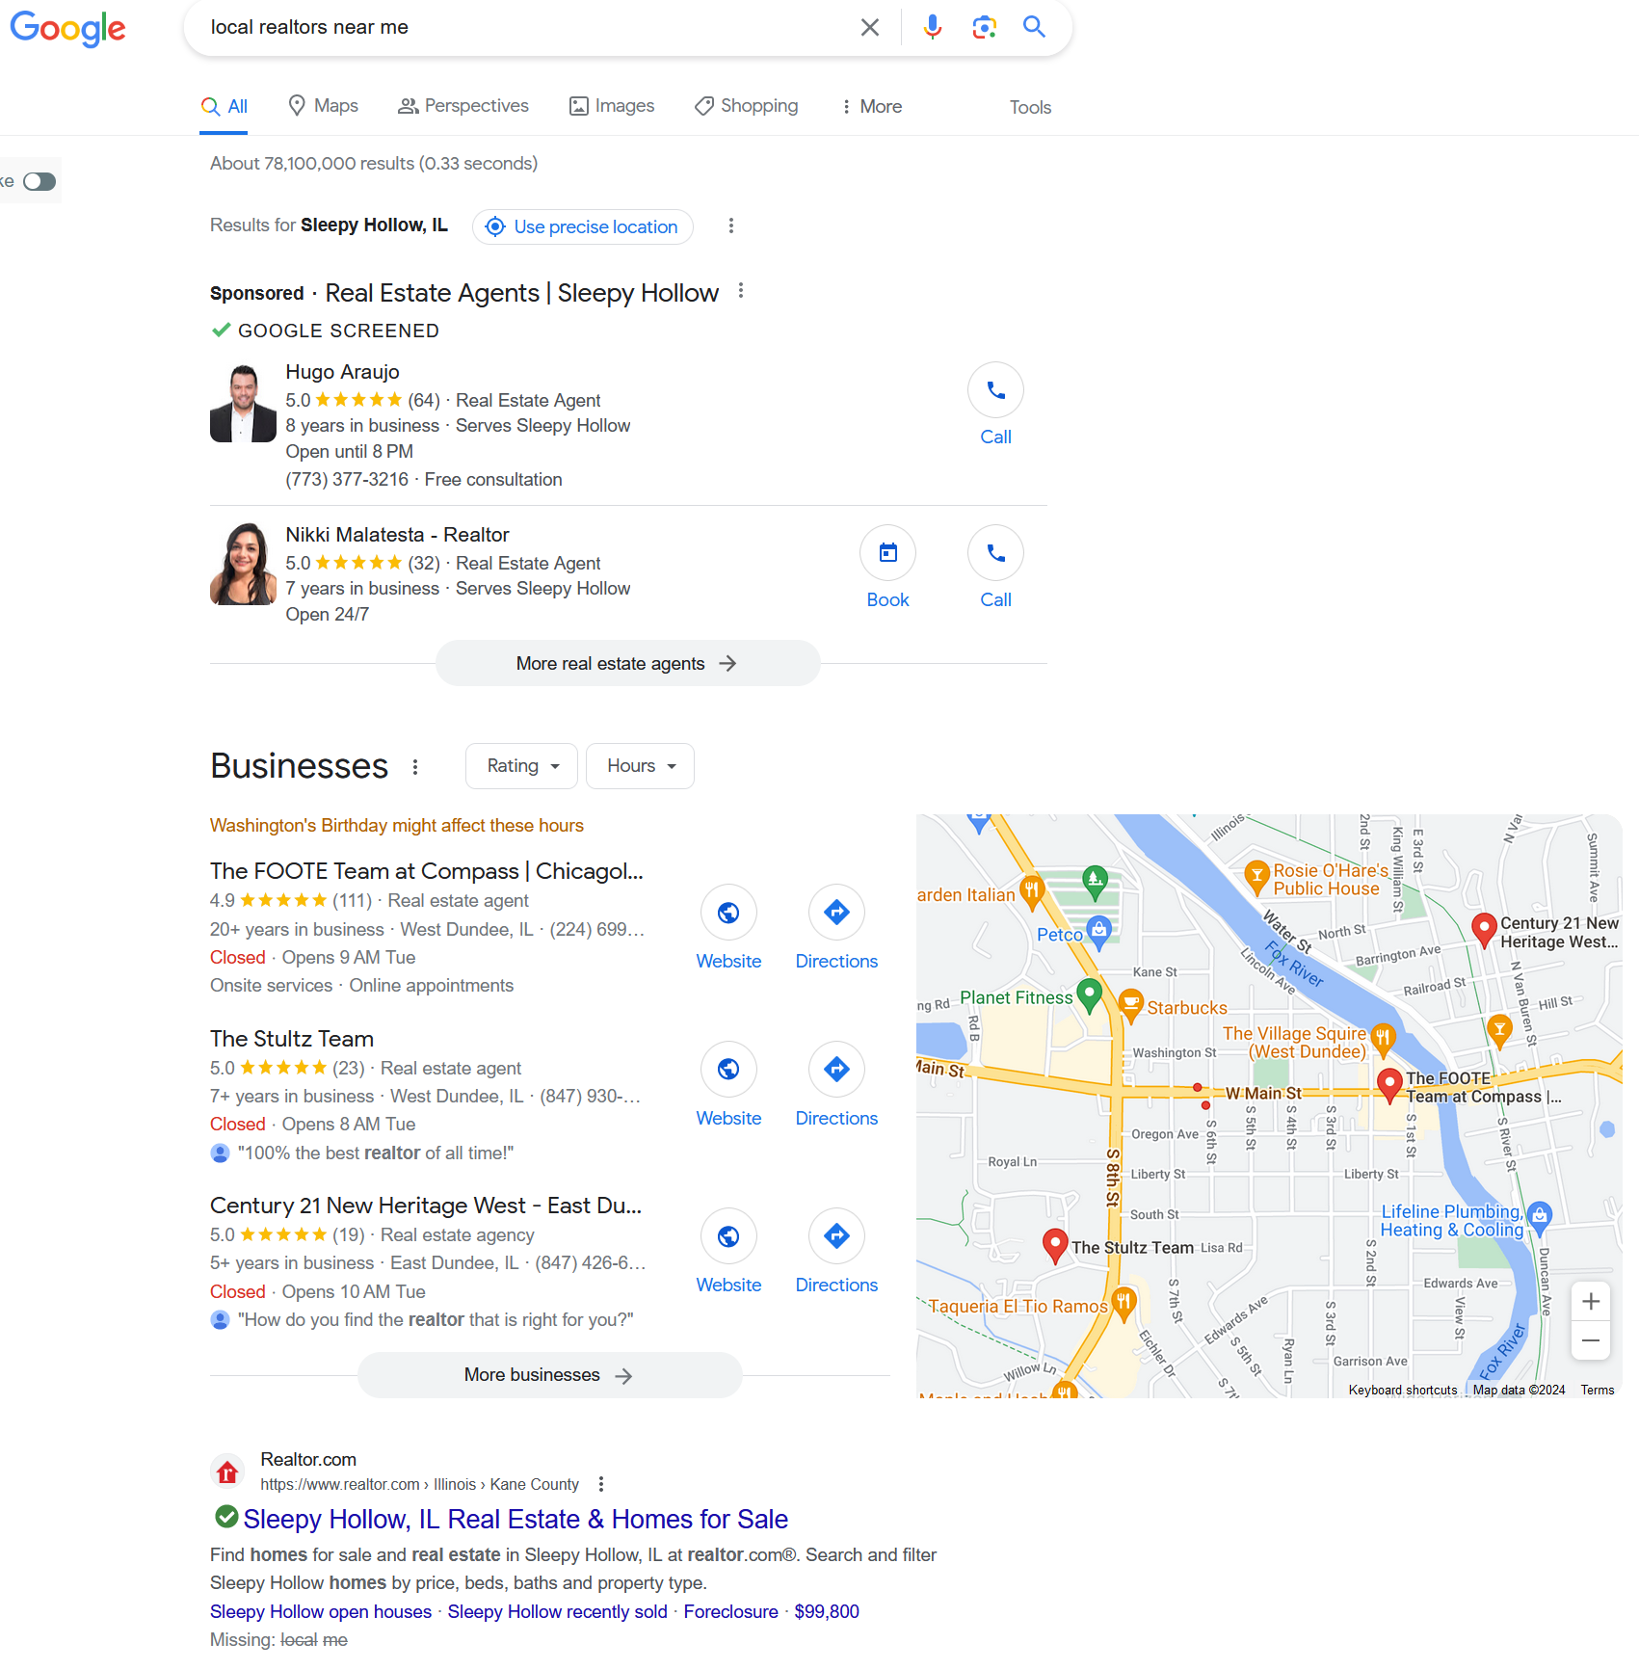
What is Google Business? Fig 2.
Search term = “local realtors near me”
About 78,100,000 results
Paid Ads
Local Listings
Start SEO Results

Slide 20
Google Business – How To Get Started
Get a free Gmail account
  This account should NOT be associated with your personal account
  This account should be used for other Google products
    Google Business
    Google Analytics
    Google Ads
    Google Search Console
    Google Tag Manager
    Google Optimize
  Type in your business location
  Attempt access or try to claim your listing
  If you cannot claim your listing appeal to Google for ownership
  If someone has already claimed your listing – reach out to Google for ownership [follow directions]
  If needed, create a new listing
  Start building out your listing in full
  If all else fails…call Searchology at 1.312.316.7202 or email altonjd2@gmail.com for additional assistance free of charge.
Google Business Live Demonstration

Slide 21
Google Business – Opportunity Knocks
How to improve your listing:
Take over your listing
Upload images
Update your listings with events, news, updates, blog posts, logos, and more
Utilize the “events” feature for parties, gatherings, open house, listings, etc.
Upload product information
Add/edit services
Update business vitals
Upload promotions
Select “geo-targeting” options
Ask/Answer questions
Manage and request reviews
Track inbound phone calls and direction requests
Update staff profiles

Slide 22
Google Business – Daily/Weekly Activity
Top activities you should update frequently:
Update your current listings, homes, and apartments – use the ‘image’ update tool
Update any open house events, networking, or gatherings – ‘event updates’
Update your services and staff profiles/offerings
Read & respond to reviews [positive and negative]
Always ask for reviews – share review link[s]
Share updates from blogs or other crafted material [PDFs, images, video, links, etc.] to ‘updates’
Update and post “offers” – may or may not be used with housing/apartments
MONTHLY –
Review your monthly performance

Slide 23

If you enjoyed this presentation…
Kindly Leave Reviews by Following the Links Below
Google Business Reviews
https://g.page/r/CSPMh7fWNxVUEB0/review
Facebook Reviews
https://www.facebook.com/searchology/reviews

Slide 24
Thank you
Alton J. Duderstadt II
www.Searchology.biz
Email: altonjd2@gmail.com
Text/call: 1.312.316.7202

